Slide 1
GEN AI IN DATA PROFILING
Team Name: Dream Team Innovators
Team Members:
- Neeraj Sukheja
- Anand Haridasan
- Sneha Sethia
- Jeena Manuel
- Arabinda Mishra

Slide 2
Problem Statement
- Manual rule extraction is time-consuming and error-prone
- High risk of non-compliance and penalties
- Need for AI-driven rule extraction and validation

Slide 3
Inspiration Behind the Solution
- Regulatory compliance is complex and evolving
- AI can automate rule extraction and validation
- Reduces manual effort and increases accuracy
- Enables reusability of extracted rules

Slide 4
What It Does
✅ Extracts rules from regulatory text using AI
✅ Applies rules to uploaded datasets
✅ Generates Python validation scripts
✅ Flags non-compliant records and suggests fixes
✅ Uses ML for anomaly detection
✅ Generates downloadable reports

Slide 5
How We Build It
- **Frontend:** React.js / Next.js
- **Backend:** Node.js (Express.js)
- **Database:** MongoDB
- **AI Processing:** OpenAI GPT for rule extraction & Python script generation
- **Validation & ML:** Python (pandas, NumPy, scikit-learn)
- **Storage & Processing:** Cloud storage, worker queues

Slide 6
Challenges We Faced
🚧 Complex regulatory text interpretation
🚧 Ensuring accuracy in rule extraction
🚧 Automating Python code generation & execution
🚧 Handling large datasets efficiently
🚧 Integrating ML for anomaly detection
🚧 Ensuring security & compliance

Slide 7
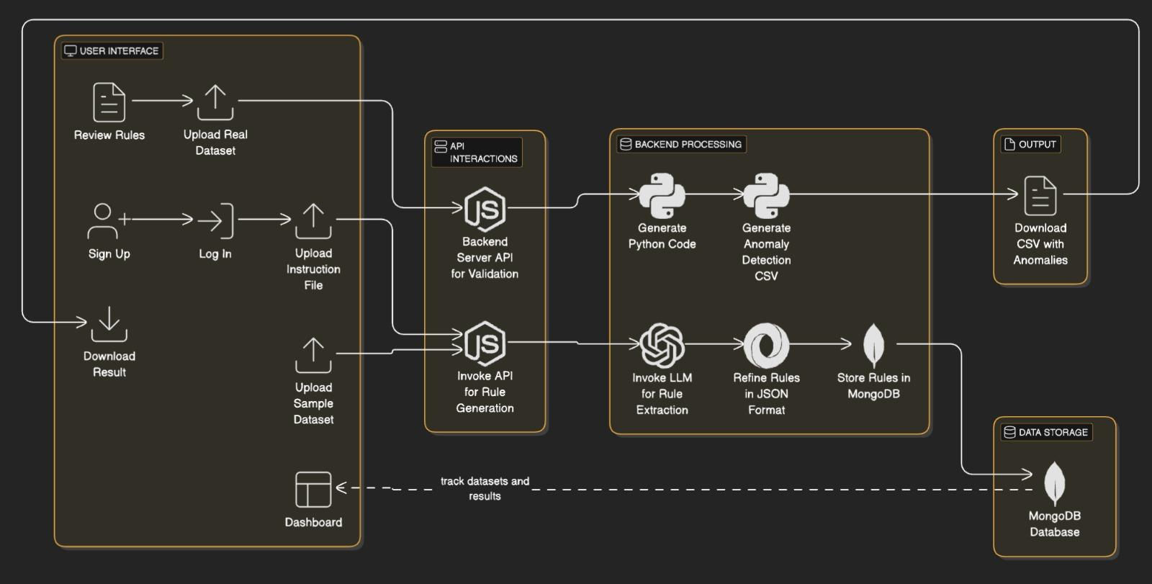
Architectural Design

Slide 8
Conclusion & Next Steps
Successfully automated regulatory compliance validation
Improved efficiency, accuracy, and scalability
Future Enhancements:
Improve AI model accuracy
Enhance real-time processing capabilities

